Slide 1
GTT Company Overview

Slide 2
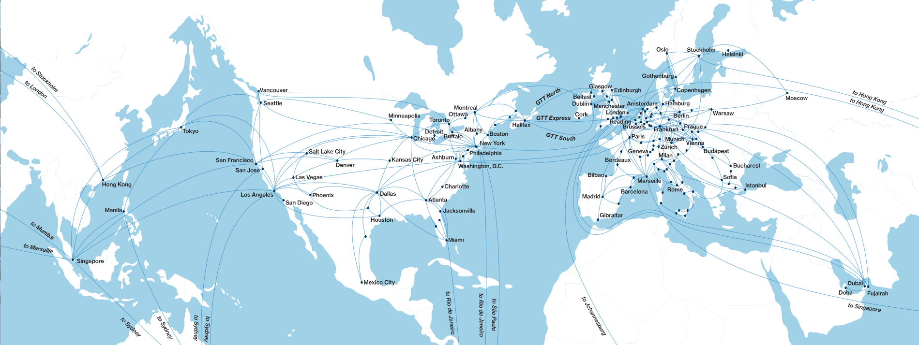
We Connect People Across Organizations, Around the World and to Every Application in the Cloud.

Slide 3
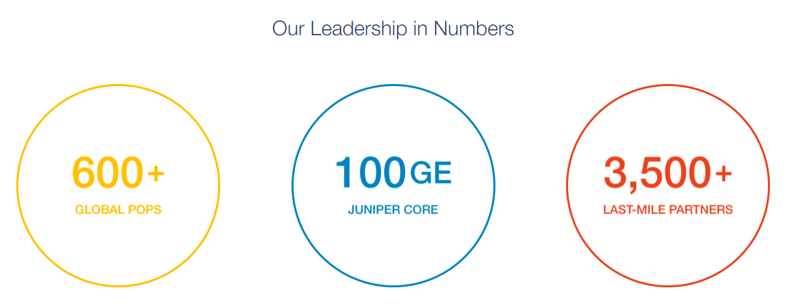

Slide 4
Company Portfolio
Notes:
GTT offers a comprehensive portfolio of network services, including SD-WAN, wide area networking, internet, transport and infrastructure, and managed services. GTT SD-WAN leverages the company’s global, Tier 1 IP network to connect client locations diversely and securely to any destination on the internet or to any cloud service provider.

Slide 5
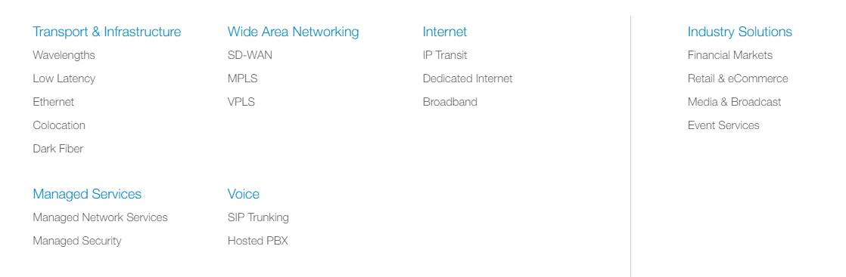
Our Services

Slide 6


Slide 7
Company Culture

Slide 8

In GTT we believe in
Simplicity – We are easy to work with
Speed – We are fast and responsive
Agility – We strive to say “yes”
CRAZY GROWTH in every possible aspect
Notes:
GTT is redefining global communications to serve a cloud-based future, connecting people across organizations, around the world and to every application in the cloud. Our clients benefit from an outstanding service experience built on our core values of simplicity, speed and agility. A Fortune Future 50 company, GTT owns and operates a global Tier 1 internet network and provides a comprehensive suite of cloud networking services to any location in the world. For more information on GTT, please visit www.gtt.net.

Slide 9
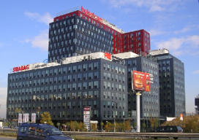
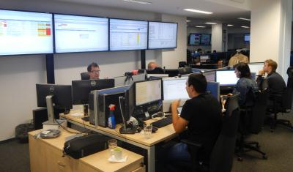
GTT in Bulgaria
GTT (Ex-Interoute) presence in Bulgaria since 2006
  Strategic decision to locate the O&E centre: 2010
Rapid growth since 2011
  More than 700 employees at this moment and counting
All technological networking areas
  Transmission (DWDM, SDH)
  IP/MPLS
  Voice/Video
  Computing
All key functional areas
  Network design and build
  Service delivery
  Network operations
  Customer support
9
Notes:
Network virtualization is a method of combining the available resources in a network by splitting up the available bandwidth into channels, each of which is independent from the others, and each of which can be assigned (or reassigned) to a particular server or device in real time. The idea is that virtualization disguises the true complexity of the network by separating it into manageable parts, much like your partitioned hard drive makes it easier to manage your files.
Storage virtualization is the pooling of physical storage from multiple network storage devices into what appears to be a single storage device that is managed from a central console. Storage virtualization is commonly used in storage area networks (SANs).
Server virtualization is the masking of server resources (including the number and identity of individual physical servers, processors, and operating systems) from server users. The intention is to spare the user from having to understand and manage complicated details of server resources while increasing resource sharing and utilization and maintaining the capacity to expand later.

Slide 10
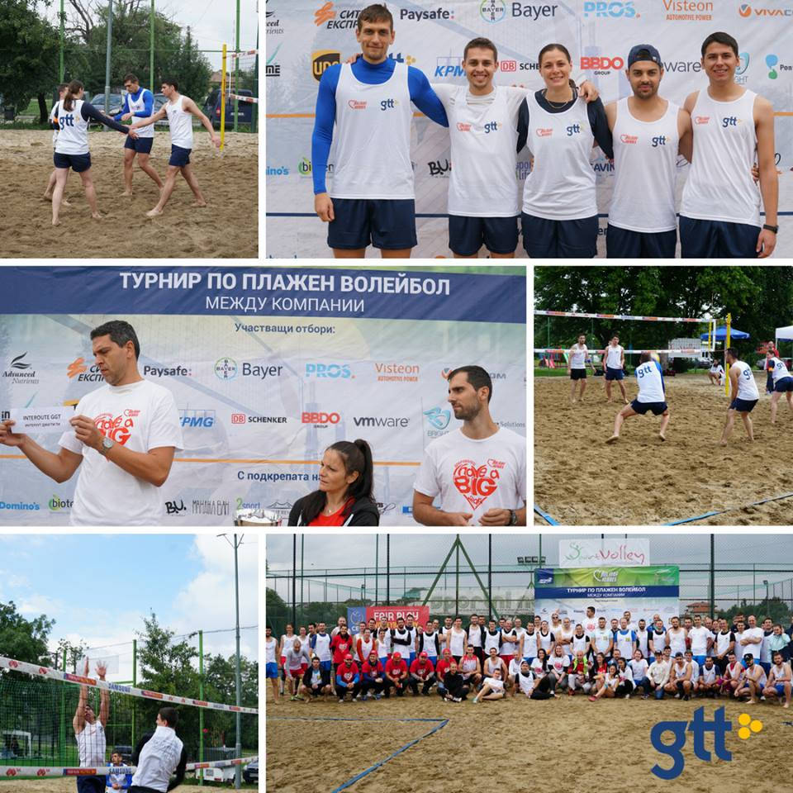
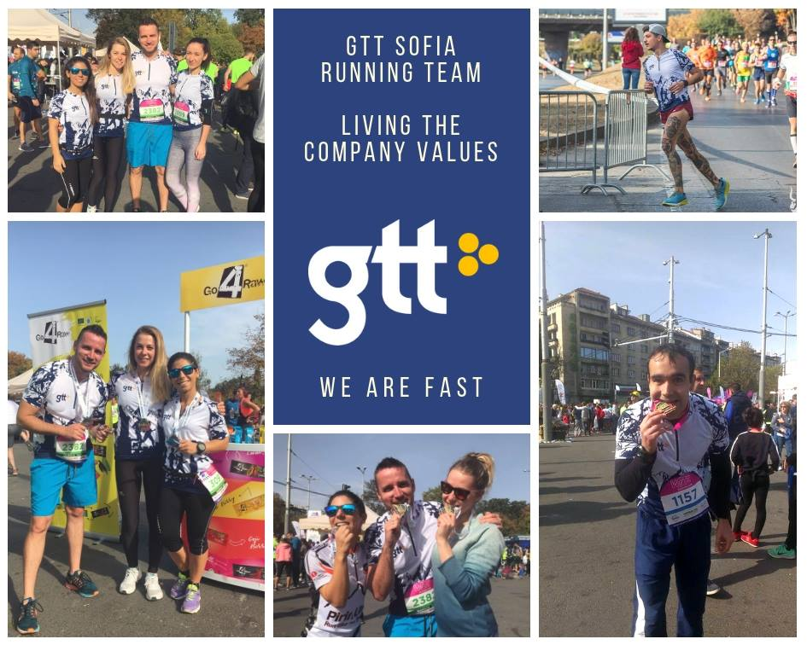

GTT’s Team Spirit
Cross Team Building Committee
  Looking after all team building events and regular Friday breakfasts
Sport Teams
  Running, Football, Volleyball
Charity events
  We combine creativity with doing good
Trainings
  External and internal opportunities to enhance
10
Notes:
Network virtualization is a method of combining the available resources in a network by splitting up the available bandwidth into channels, each of which is independent from the others, and each of which can be assigned (or reassigned) to a particular server or device in real time. The idea is that virtualization disguises the true complexity of the network by separating it into manageable parts, much like your partitioned hard drive makes it easier to manage your files.
Storage virtualization is the pooling of physical storage from multiple network storage devices into what appears to be a single storage device that is managed from a central console. Storage virtualization is commonly used in storage area networks (SANs).
Server virtualization is the masking of server resources (including the number and identity of individual physical servers, processors, and operating systems) from server users. The intention is to spare the user from having to understand and manage complicated details of server resources while increasing resource sharing and utilization and maintaining the capacity to expand later.

Slide 11
Career with GTT
By joining GTT you will have the chance to observe the whole lifecycle of cloud networking services.
In which part of this lifecycle you can contribute? This is completely up to your knowledge, skillset and career aspirations.
We have career and development opportunities in the following areas:
IP Networking
Cloud Hosting
Voice and Video
Transmission
Information Security
Project Management
Finance
Notes:
GTT is redefining global communications to serve a cloud-based future, connecting people across organizations, around the world and to every application in the cloud. Our clients benefit from an outstanding service experience built on our core values of simplicity, speed and agility. A Fortune Future 50 company, GTT owns and operates a global Tier 1 internet network and provides a comprehensive suite of cloud networking services to any location in the world. For more information on GTT, please visit www.gtt.net.

Slide 12

Application and Interview Process
Apply for a position in GTT via:
Our website – www.gtt.net
Jobs.bg - https://www.jobs.bg/company/16092
LinkedIn - https://www.linkedin.com/company/gtt/
Keep in touch with TA team at:
recruitbgteam@gtt.net
What are we looking for in a candidate?
What can you expect of an interview with GTT?

Slide 13
Questions?

Slide 14
THANK YOU

